Slide 1

Large-Scale and Multi-Structured Databases Project Design WeFood
Cleto Pellegrino
Giovanni Ligato
Giuseppe Soriano

Slide 2
Application Highlights
This is a snapshot of the main features of the proposed application:
Upload recipes with ingredients and pictures;
Review other users’ recipes with stars and comments;
Follow other users to see their recipes;
Search for new recipes applying filters like ingredients;

Slide 3
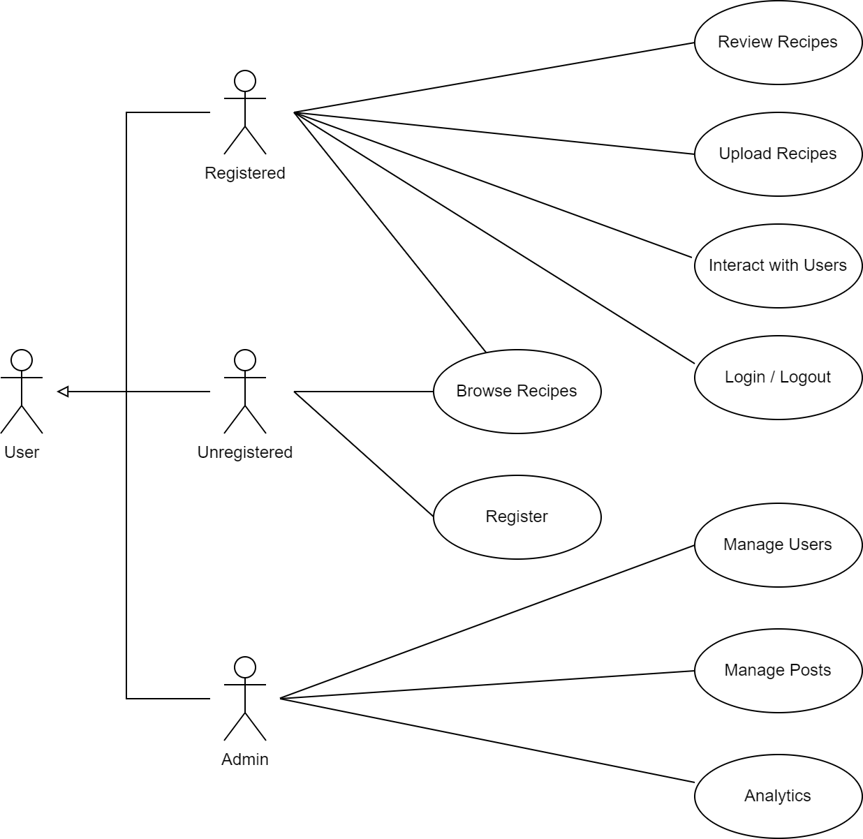
Actors and main supported functionalities
Here’s a simplified use case diagram.

Slide 4
Dataset Description
Source:
Calories.info - Calories in Food Items (per 100 grams)
Food.com - Recipes and Interactions
Food.com - Recipes and Reviews
Description: A group of datasets which contains recipes posted by users with their respective reviews and interactions done by other users. There is also a list of food with some info about calories.
Volume: Around 1 GB. Specifically: 2225 food items; 180K+ recipes and 700K+ recipe reviews; over 500,000 recipes and 1,400,000 reviews.
Variety: Calories.info and Food.com
Velocity/Variability: N/A

Slide 5
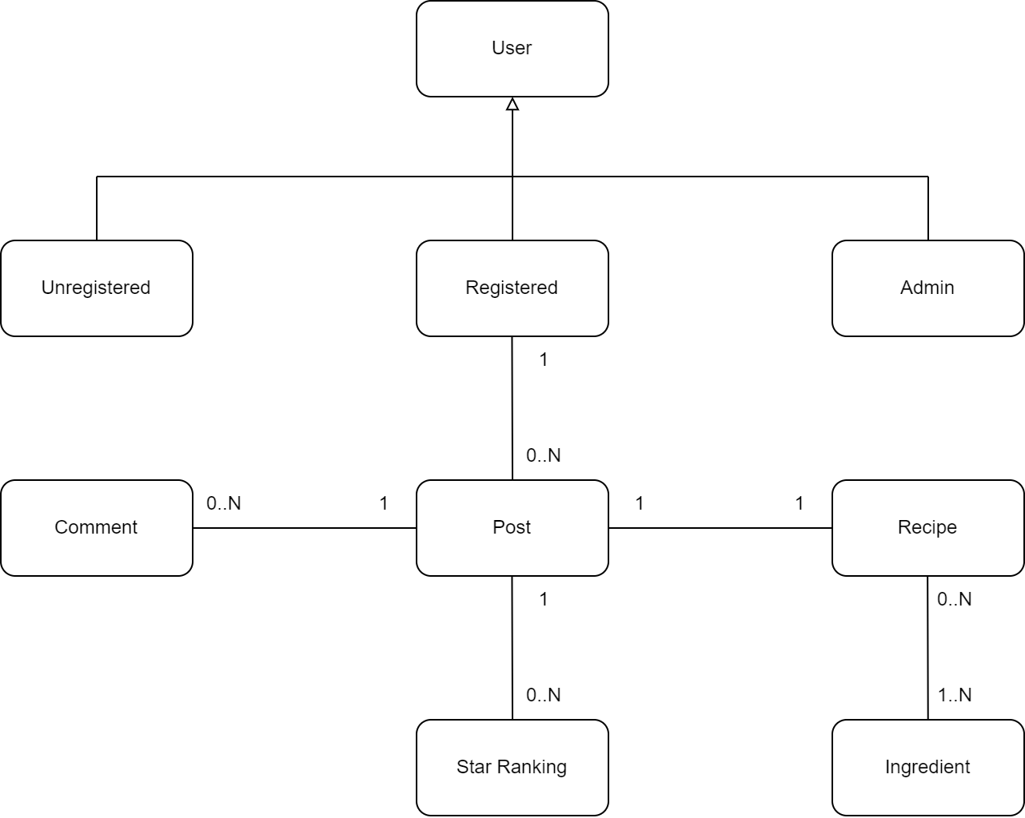
Preliminary UML Class Diagram

Slide 6
Requirements and Entities handled by Document DB
Entities:
User
Post
Recipe
Ingredient
Comment
Star Ranking
Requirements:
Analytics for the Admin to keep track of the social network state (i.e. most/less active users, etc.).
Allow users to look for new recipes filtering the ingredients.
Allow users to retrieve all previous published posts and check out comments and ratings below them.

Slide 7
Requirements and Entities handled by Key-Value DB
Post degli amici pubblicati nelle ultime 48 ore per avere un caricamento veloce dei post della home.
Ingredients nel key-value.

Slide 8
Requirements and Entities handled by Graph DB
Entities:
User
Ingredient
Requirements:
To suggest to a user other users depending on the current common friends.
To suggest to a user other possible recipes based on the ingredients he/she used before.

Slide 9






Software Architecture Preliminary Idea
Here are the frameworks and tools that the group would like to use (programming languages, DBMSs, etc..)

